Slide 1
Active Control of Cart Pole Problem Using Reinforcement Learning
By
Anirudh Topiwala
UID: 115192386

Slide 2
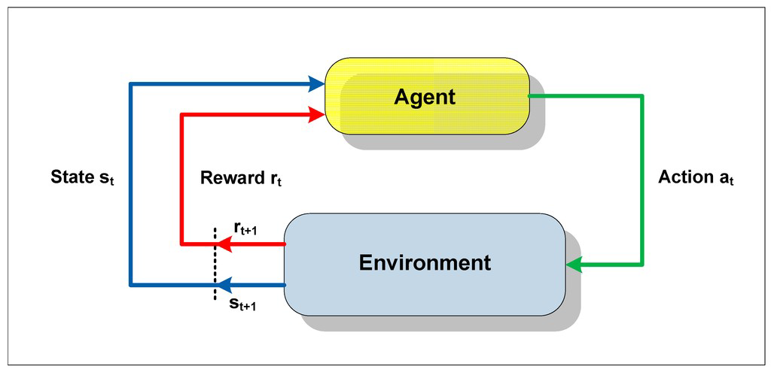
Reinforcement Learning
Objective: Find a policy π that maximizes the cumulative discount reward.
A policy π is a function that decides what action should the agent take.
Notes:
A class of learning algorithms that attempt to estimate, explicitly or implicitly, the value of the states experienced
by the agents in order to favor the choice of those actions that maximize the amount of positive reinforcement received by the agent over time.
It concerns a family of problems in which an agent evolves while analyzing consequences of its actions, thanks to a simple scalar signal (the reinforcement) given out by the environment.
Reinforcement learning has various modifications namely value based learning, policy based learning, model based learning etc. which leads to various learning methods. We are using Q-Learning method as it is better compared to Monte Carlo Method or Dynamic Programming Method as it bootstraps as well as samples.

Slide 3
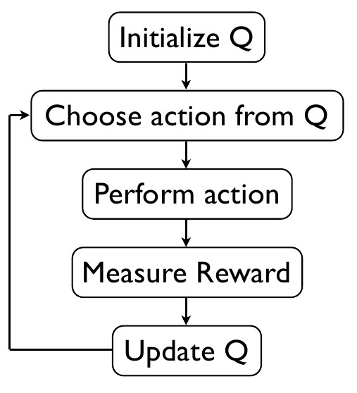
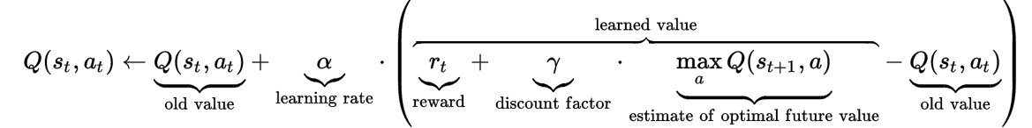
Q - Learning
Notes:
Reward Function defines the reinforcement that has to be provided to the agent for a particular state. Discount factor is the factor that diminishes/enhances the effect of future rewards on the Q-value of the current state-action pair. Learning rate, as the name suggests, is the rate of learning the various Q-values.

Slide 4
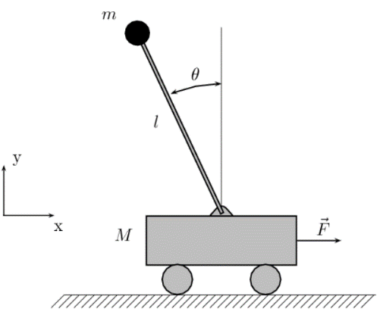
Cart Pole Problem
A pole is attached to the cart which can move on a frictionless track.
The pole is kept upright by applying a force of +1 or -1.
I have used OpenAI gym to simulate the problem.
Functions like: next_state , reward, done, info = env.step(action) are readily available.
The Episode end when the pole is 15` away from the vertical on either side or the cart moves 2.4 units from the center.
V1 was later used as it gave more time steps
to balance (500).
Notes:
After each time step the pole is vertical a reward of +1 is given to algorithm. If it fails the reward is 0

Slide 5
Simulation
The continuous states are divided into buckets.
State | Position | Velocity | Angle | Angular velocity
Discrete space | 3 | 3 | 6 | 3
Angle | >=15 | 6-10 | 0-5 | 0-(-5) | -6-(-10) | -15=<
Action | 0 | -1 | -1 | +1 | +1 | 0

Slide 6
Optimization Carried Out
Change in state space.
Displacement and velocity are ignored.
New state space distribution: (1,1,6,3)

Slide 7
Optimization Carried Out
Episodes to converge | Best Q | Learning Rate
305 | 99.368716 | 0.5
259 | 99.487325 | 0.3
234 | 99.529058 | 0.1
267 | 97.024772 | 0.01
287 | 97.528066 | 0.001
Very high learning rate increases the variance.
Very low learning rate may not allow the function to learn.
Notes:
The learning rate was always decreased logarithmically from 0.5 to the min_learning rate. We can infer from the table above that the minimum learning rate of 0.1 is giving the best results. This is because with a higher learning rate, we are allowing the new results to overpower the old results very suddenly and increase the variance. Whereas if the learning rate is too low, then the new results are virtually discarded, and the function takes time learning.

Slide 8
Optimization Carried Out
Episodes | Best Q | Min Exploration Rate
366 | 99.930757 | 0.1
234 | 99.256767 | 0.01
289 | 99.675968 | 0.001

Slide 9
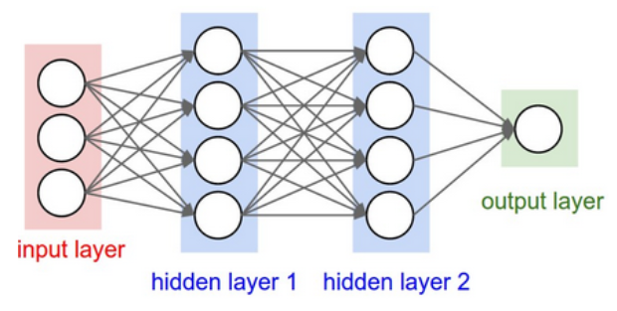
Deep Q learning
This is achieved by replacing the Q table by neural networks.
Used Keras to implement the
DQN.
Model: Sequential
Input layer= 4 state spaces
Hidden layers= 2 layers of 24 nodes each(dense). Activation: relu
Output layer = 2 as we only have two actions, Activation: Linear
Optimizer: Adam
Loss function: mse (mean squared error)

Slide 10
Deep Q learning
Use of Experience Replay: (randomizes over data)
Stores the experience in a replay buffer and randomly samples mini batches from it to train the network.
Therefore, randomizing breaks the correlations and reduces the update variance.
Target Network:
This is done in order to reduce the oscillations and break correlations between the Q network and the target.
Freeze the network when the perfect score is obtained.

Slide 11
Results
Deep Q Network: Trained for 2177 episodes using 2 hidden layers. It took around 8 mins to train the network.
The link to the simulation :
https://youtu.be/x-snt2aYUHU
Normal Q learning: 234 episodes
The Link to the simulation:
https://youtu.be/VSWLg6mRL9g
The link to the codes can be found here: https://drive.google.com/drive/folders/1VJiIQc60Jp_bAWOmdoX7uYc3a5XGMJJ6?usp=sharing

Slide 12
References
Roberge, J. K. (1960). The mechanical seal. PhD thesis, M.I.T., Cambridge, Massachusetts.
https://medium.com/@tuzzer/cart-pole-balancing-with-q-learning-b54c6068d947
https://gist.github.com/n1try/2a6722407117e4d668921fce53845432
https://en.wikipedia.org/wiki/Q-learning#Learning_rate
Lecture Notes: Lecture8 (Q-Learning and Actor-Critic Methods)
https://ferdinand-muetsch.de/cartpole-with-a-deep-q-network.html
https://keon.io/deep-q-learning/
Mnih, V., Kavukcuoglu, K., Silver, D., Rusu, A. A., Veness, J., Bellemare, M. G., Graves, A., Riedmiller, M., Fidjeland, A. K., Ostrovski, G., Petersen, S., Beattie, C., Sadik, A., Antonoglou, I., King, H., Kumaran, D., Wierstra, D., Legg, S. & Hassabis, D. (2015). Human-level control through deep reinforcement learning. Nature, 518, 529--533.

Slide 13
Questions?

